Slide 1



01
STUDENTS, STRESS AND SLEEP
- UNDERSTANDING THE CONNECTION -

Slide 2


02
Index
PROBLEM
01
Introduction
Introduction to
PSQI and it’s Calculation
02
03
Analaysing the results
Conclusion and solutions
02

Slide 3
03
Introduction
Overview of the Project
Project Aims
Based upon examination of how stress levels experienced by students intertwine with the quality of their sleep,
Ultimately shaping their acedemic as well as overall well-being.
At the core of our study lies the Pittsburgh Sleep Quality Index (PSQI).
To unravel the intricate dynamics between stress, sleep, and student well-being.
Offer a comprehensive understanding of the sleep patterns of university students, using PSQI.
To contribute valuable insights to the student mental health and well-being.
Notes:
Make it in points

Slide 4



04
Importance
Why does this matter? In the academic hustle, students face a delicate balance, and understanding the relationship between stress and sleep is paramount. This study isn't just about numbers; it's about enhancing the support structures within our educational institutions, promoting healthier student experiences, and contributing to the broader conversation on mental health in academic settings.
Notes:
Make this in points

Slide 5


05
Demographics:
Survey results show that 68.2% respondents were of age group 17-20.
Moreover around 81% of respondents were male.

Slide 6


06
Q) Do you believe that the quality of your sleep affects your overall mental health?
-More than 85% of the respondents agreed that the quality of the sleep they get highly affects their overall mental health.

Slide 7
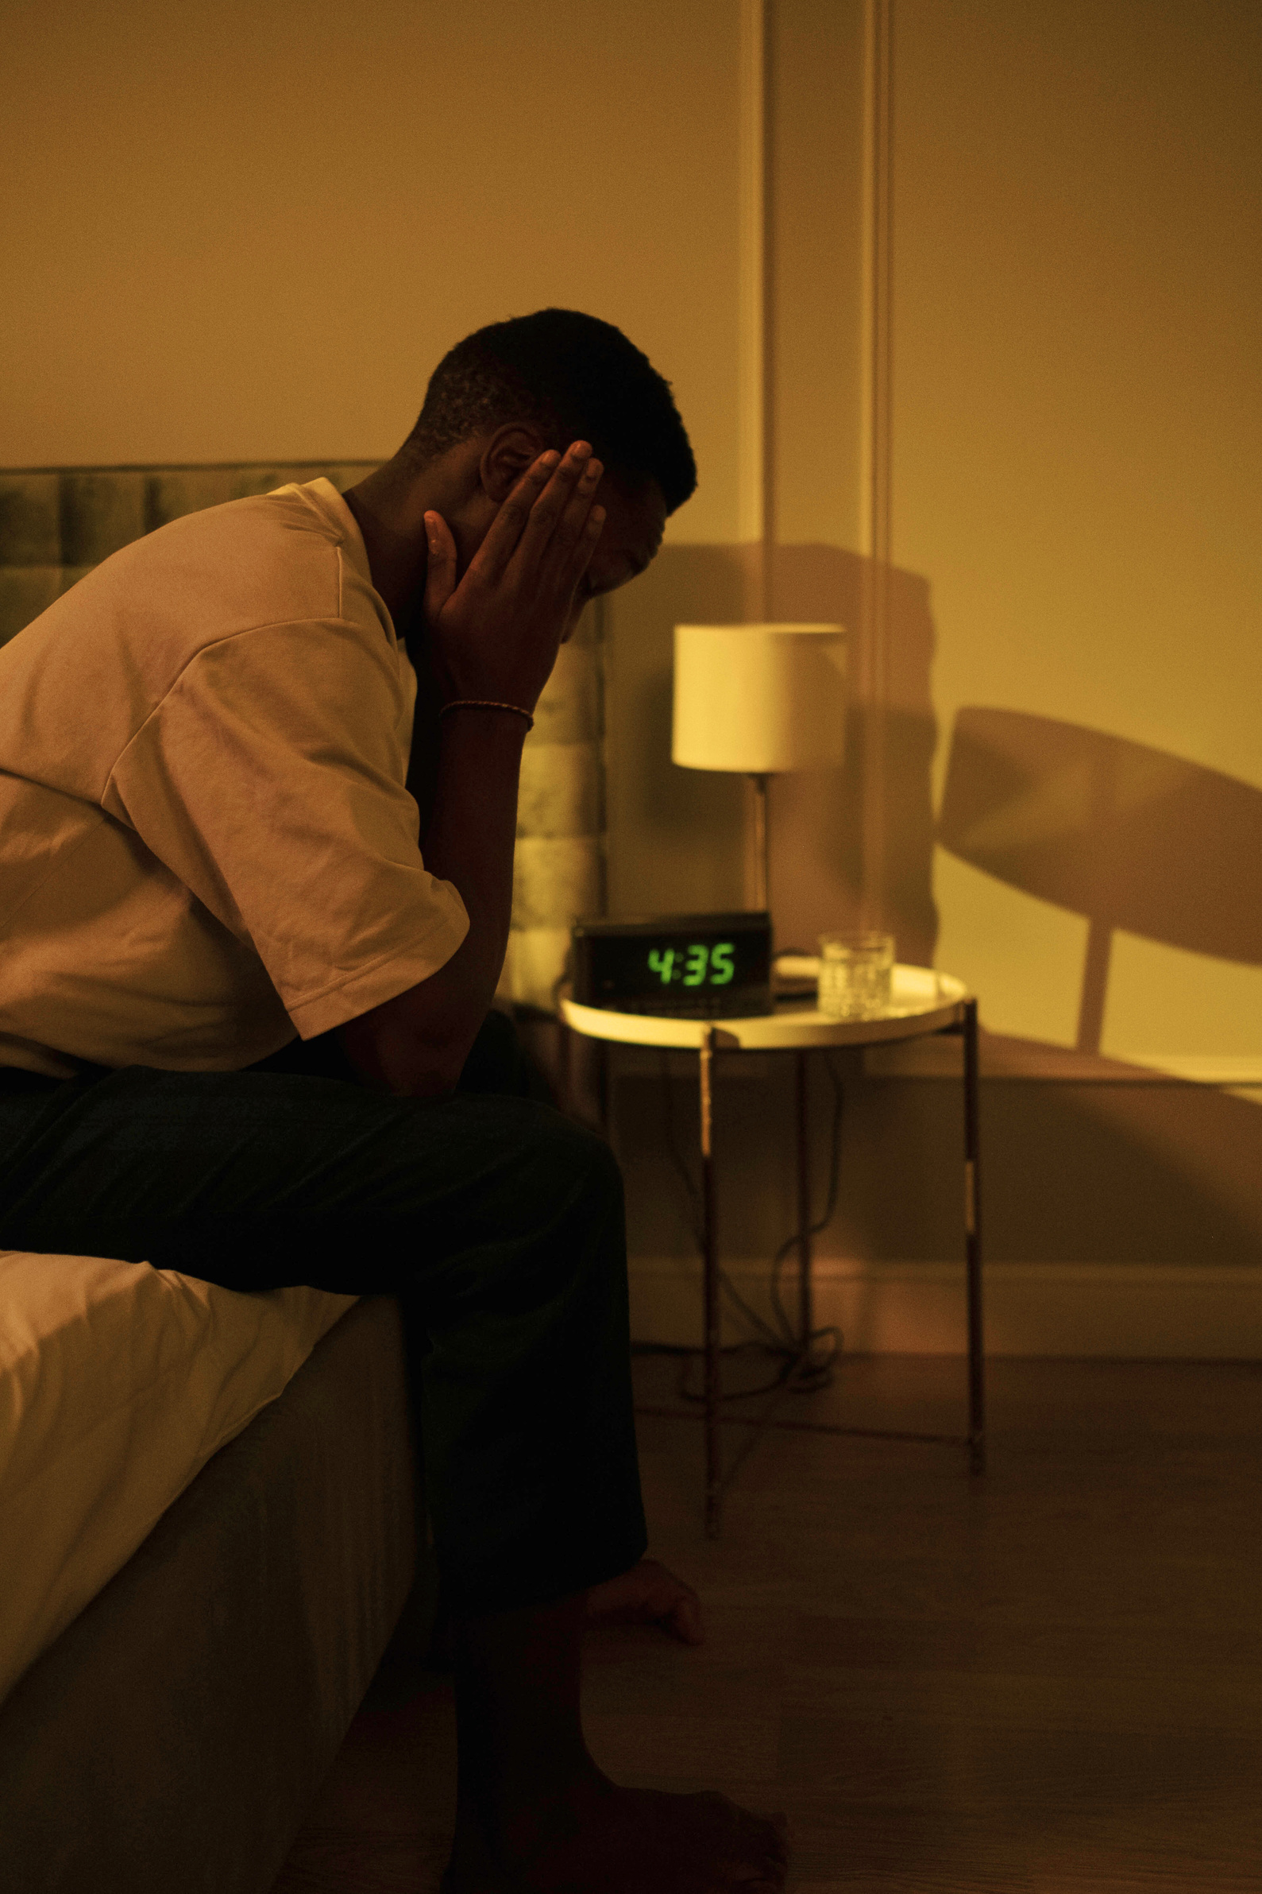
07
Introduction to PSQI and it’s Calculation

Slide 8
What is PSQI?
How is it used?
Assessment Tool:
The Pittsburgh Sleep Quality Index (PSQI) is a standardized questionnaire used as an assessment tool to evaluate the quality of sleep in individuals.
Self-Report Questionnaire:
PSQI is a self-report questionnaire, typically completed by individuals, providing subjective information about their sleep habits and patterns.
Comprehensive Evaluation:
Comprising of several questions distributed in 7 components of sleep, it provides a comprehensive picture of an individual’s sleep quality.
Scoring System:
Each component is scored on a scale of 0 to 3, and the scores are summed to generate a total score, with higher scores indicating poorer sleep quality. A global PSQI score above a certain threshold suggests the presence of sleep disturbances or disorders.
Widely Utilized:
Highly acclaimed in both clinical and research settings, PSQI is a popular tool to identify sleep disorders and patterns.
Notes:
Scoring System: Each component is scored on a scale of 0 to 3, and the scores are summed to generate a total score, with higher scores indicating poorer sleep quality. A global PSQI score above a certain threshold suggests the presence of sleep disturbances or disorders.

Slide 9

09
7 components of PSQI:
Subjective
Sleep Quality
Sleep Latency
Sleep Duration
Use of Sleep Medication
Sleep Efficiency
Sleep Schedule
Daytime Dysfunction

Slide 10
Component 1 - Subjective Sleep Quality
Description:
Participant's self-rated perception of overall sleep quality, indicating how they feel about the restfulness of their sleep
Business proposals can boost revenues for your firm
Question asked:
On a scale of 1-10 how would you describe the overall quality of your sleep in the past month?
Key used:
1-2 = Very Bad
3-5 = Fairly Bad
6-8 = Fairly Good
9-10 = Very Goodd
Notes:
Description:
Participant's self-rated perception of overall sleep quality, indicating how they feel about the restfulness of their sleep
Question asked:
On a scale of 1-10 how would you describe the overall quality of your sleep in the past month?

Slide 11

11
Results of Component 1
The majority of respondents (65%) reported either "Very Good" or "Fairly Good" subjective sleep quality, suggesting a generally positive perception of their own sleep.
However, a significant portion (33%) rated their sleep quality as "Fairly Bad" or "Very Bad," indicating that a notable proportion of participants perceive their sleep as less than optimal.
These findings highlight the subjective nature of sleep quality assessments and the varying experiences within the surveyed population
F
Notes:
animation lagao in every slide

Slide 12
12
Component 2 - Sleep Latency
Description:
The time it takes for an individual to fall asleep after getting into bed, reflecting the ease or difficulty of initiating sleep.
Business proposals can boost revenues for your firm
Question asked:
How long did it typically take you to doze off each night in the past month? (in minutes)
Notes:
Description:
Participant's self-rated perception of overall sleep quality, indicating how they feel about the restfulness of their sleep
Question asked:
How long did it typically take you to doze off each night in the past month? (in minutes)

Slide 13

13
Results of Component 2
The majority of respondents (38.6%) reported a sleep latency of less than 15 minutes, indicating a relatively quick transition from wakefulness to sleep.
However, around 51% of participants experienced a longer sleep onset, with 36.4% taking 15 to 30 minutes and 25% requiring more than 30 minutes to fall asleep.
This pattern suggests the presence of underlying problems related to sleep initiation. The prolonged sleep latency may indicate factors such as heightened stress, anxiety, or other sleep-disrupting influences.
Notes:
animation lagao in every slide

Slide 14
14
Component 3 - Sleep Duration
Description:
Provides an overview of the actual quantity of undisturbed sleep obtained at night time.
Business proposals can boost revenues for your firm
Question asked:
How many hours of actual sleep did you manage to get at night in the past month? (This may differ from the time you spent in bed.)
Notes:
Description:
Participant's self-rated perception of overall sleep quality, indicating how they feel about the restfulness of their sleep
Question asked:
How long did it typically take you to doze off each night in the past month? (in minutes)

Slide 15

15
Results of Component 3
A notable 63.6% of respondents reported inadequate sleep, with 54.6% getting less than 5 hours and another 9% between 5 to 7 hours.
Merely 36.4% reported meeting the recommended. More than 7 hours
This prevalent pattern underscores a concerning trend in insufficient sleep among university students, potentially impacting their well-being, academic performance, and mental health.
Notes:
animation lagao in every slide

Slide 16
Component 4 - Habitual Sleep Efficieny
Description:
The ratio of actual time spent asleep to the total time spent in bed. A lower ratio may suggest difficulty maintaining continuous sleep.
Questions used for caluclation of ratio:
Q1) At what time did you generally go to bed during the last month?
Q2) What time did you usually rise in the morning over the past month?
Q3) How many hours of actual sleep did you manage to get at night in the past month? (This may differ from the time you spent in bed.)
Formula used :
Sleep efficiency = (# hours slept/# hours in bed) X 100%
# hours slept — question 3
# hours in bed — question 2 - question 1
Notes:
Description:
Participant's self-rated perception of overall sleep quality, indicating how they feel about the restfulness of their sleep
Question asked:
How long did it typically take you to doze off each night in the past month? (in minutes)

Slide 17

17
Results of Component 4
The majority of respondents (56%) reported a high habitual sleep efficiency of greater than 85%.
However, a considerable proportion of participants reported lower sleep efficiency, with 21% falling into the 75-84% range, 18% in the 65-74% range, and 5% experiencing less than 65% sleep efficiency.
These results indicate a mix of sleep efficiency levels among the surveyed population, with a notable percentage experiencing less optimal sleep efficiency.
Notes:
animation lagao in every slide

Slide 18
18
Component 5 - Sleep Schedule
Description:
Judges the regularity and consistency of students' sleep schedules.
Question asked:
Do you have a regular sleep schedule (e.g., consistent bedtime and wake time)?
Notes:
Description:
Participant's self-rated perception of overall sleep quality, indicating how they feel about the restfulness of their sleep
Question asked:
How long did it typically take you to doze off each night in the past month? (in minutes)

Slide 19

19
Results of Component 5
A notable 59% of respondents reported not having a defined sleep schedule, indicating a lack of consistency in their bedtime routines.
In contrast, 18% affirmed having a consistent sleep schedule, while 22% reported adhering to a sleep schedule only on weekdays.
These findings underscore a predominant trend of irregular sleep schedules among participants, which may contribute to variations in sleep quality and overall well-being.
Notes:
animation lagao in every slide

Slide 20
Component 6 - Use of Sleep Medication
Description:
Self-reported use of medication to aid sleep. Reflects reliance on external aids for achieving sleep.
Question asked:
How frequently did you resort to medication (sleeping pills) to aid your sleep in the past month?
Notes:
Description:
Participant's self-rated perception of overall sleep quality, indicating how they feel about the restfulness of their sleep
Question asked:
How long did it typically take you to doze off each night in the past month? (in minutes)

Slide 21

21
Results of Component 6
The data on the use of sleep medication indicates a strong preference for non-pharmaceutical sleep management, with a significant 84% reporting never using sleep medication.
A small percentage reported rare usage (9%), occasional usage (4.5%), and only 2.2% reported frequent reliance on sleep medication.
These findings underscore a predominant trend of infrequent use of sleep medication within the surveyed population.
Notes:
animation lagao in every slide

Slide 22
22
Component 7 - Daytime Dysfunction
Description:
evaluates the extent to which respondents experience difficulties in their daily functioning due to sleep-related issues.
Questions asked:
Q) How often did you struggle to stay alert while taking class, studying, or participating in social activities in the past month?
Q) How challenging was it for you to maintain enough enthusiasm to accomplish tasks in the past month?
Notes:
Description:
Participant's self-rated perception of overall sleep quality, indicating how they feel about the restfulness of their sleep
Question asked:
How long did it typically take you to doze off each night in the past month? (in minutes)

Slide 23

23
Results of Component 7
A significant 68% reported being either highly or moderately affected by sleep-related issues during the day, indicating challenges in daily functioning.
While 30% experienced a marginal impact. Only a small percentage (2.2%) reported not being affected at all.
This indicates that a majority of the students struggle to stay alert and/or find motivation during the day.
Notes:
animation lagao in every slide

Slide 24

24
Overall Results
A considerable 66% reported poor, very poor, or extremely poor sleep quality, with 36%, 18%, and 7% falling into these categories, respectively.
This highlights a notable prevalence of compromised sleep among surveyed university students, indicating challenges in achieving restful sleep.

Slide 25

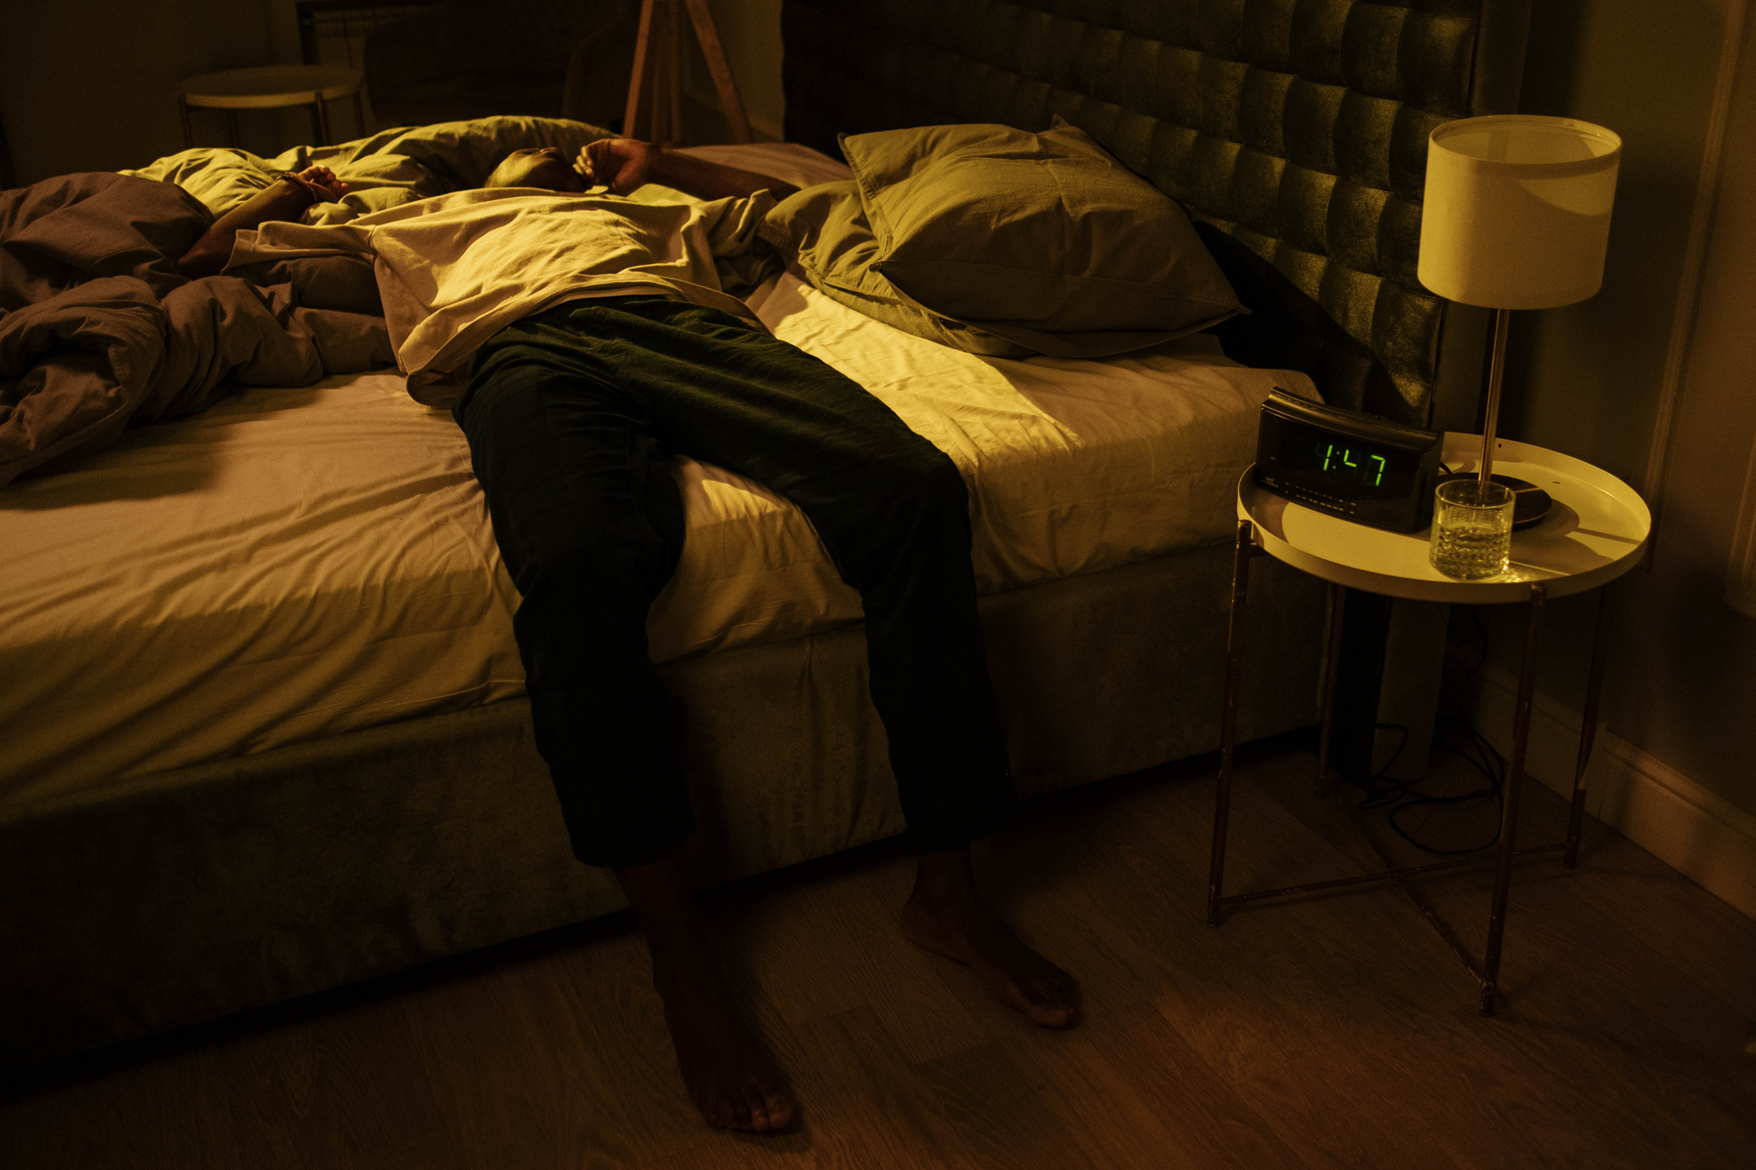

25
Results
and
Conclusions

Slide 26

26
Relationship Between Students,
Stress and Sleep.
Balancing academic pressures often leads to irregular sleep patterns and potential sleep deprivation.
Inadequate sleep contributes to heightened stress levels, impacting academic performance and overall well-being.
Elevated stress levels can disrupt sleep, creating a cyclical relationship that challenges a student's mental and physical health.

Slide 27



Solutions for Balancing
Stress, Sleep, and Student Life
27
Stress Management Workshops:
Offer workshops on effective stress management techniques, including mindfulness, relaxation exercises, and time management strategies.
Organize "Stress-Buster" events featuring therapy animals, relaxation zones with calming music, and quick stress-relief activities during high-stress periods, like exam weeks.
Sleep Hygiene Education:
Promote awareness about the importance of consistent sleep schedules and the recommended 7-9 hours of sleep.
Introduce a mobile app that provides personalized sleep tips based on individual habits and offers gentle reminders for bedtime routines.

Slide 28


Solutions for Balancing
Stress, Sleep, and Student Life
28
Establishing Campus Wellness Programs:
Implement campus-wide wellness initiatives, such as fitness classes, yoga sessions, and meditation workshops, to encourage physical activity and stress relief.
Foster a supportive environment that promotes student well-being, providing spaces for relaxation and social connection.
Academic Support Resources:
Launch an online platform that gamifies the learning experience, encouraging healthy academic competition, and collaborative problem-solving among students.
Encourage open communication between students and faculty to address academic challenges and foster a positive learning environment.

Slide 29







29
Team
Zain Baig
Abdullah
Shafiq
Asghar Ali
Muhammad Bilal
Asad Irfan
Ali Kahful
Wara
22K-4593
22K-4489
22K-4415
22k-4242
22k-4276
19k-1066

